Slide 1
COLLECTIONS AND EXCEPTION HANDLING

Slide 2
COLLECTIONS

Slide 3
The Collection in Java is a framework that provides an architecture to store and manipulate the group of objects. Java Collections can achieve all the operations that you perform on a data such as searching, sorting, insertion, manipulation, and deletion. Java Collection means a single unit of objects. Java Collection framework provides many interfaces (Set, List, Queue, Deque) and classes (ArrayList, Vector, LinkedList, PriorityQueue, HashSet, LinkedHashSet, TreeSet).

Slide 4
What is Collection in Java A Collection represents a single unit of objects, i.e., a group. What is a framework in Java It provides readymade architecture. It represents a set of classes and interfaces. It is optional. What is Collection framework The Collection framework represents a unified architecture for storing and manipulating a group of objects. It has: Interfaces and its implementations, i.e., classes Algorithm The java.util package contains all the classes and interfaces for the Collection framework.

Slide 5
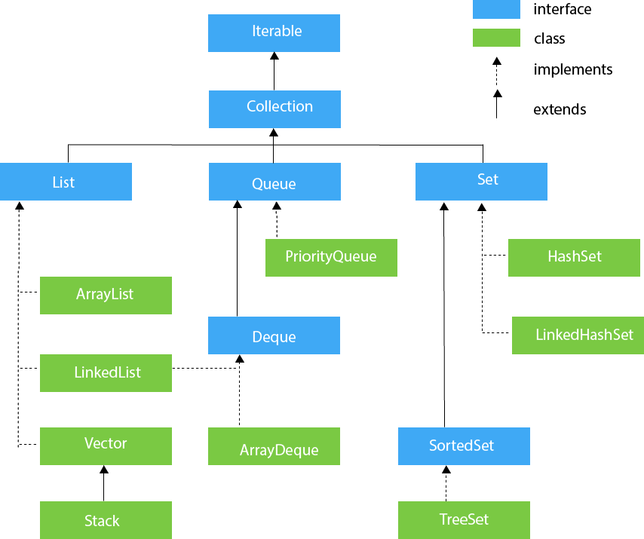

Slide 6
Iterator interface Iterator interface provides the facility of iterating the elements in a forward direction only.Methods of Iterator interface There are only three methods in the Iterator interface. No MethodDescription 1public boolean hasNext() It returns true if the iterator has more elements otherwise it returns false. 2public Object next() It returns the element and moves the cursor pointer to the next element. 3public void remove() It removes the last elements returned by the iterator. It is less used. Iterable Interface The Iterable interface is the root interface for all the collection classes. The Collection interface extends the Iterable interface and therefore all the subclasses of Collection interface also implement the Iterable interface. It contains only one abstract method. i.e., Iterator<T> iterator() It returns the iterator over the elements of type T.

Slide 7
Collection Interface The Collection interface is the interface which is implemented by all the classes in the collection framework. It declares the methods that every collection will have. The Collection interface builds the foundation on which the collection framework depends. Methods of Collection interface are Boolean add ( Object obj), Boolean addAll ( Collection c), void clear(), etc. which are implemented by all the subclasses of Collection interface. List Interface List interface is the child interface of Collection interface. It inhibits a list type data structure in which we can store the ordered collection of objects. It can have duplicate values. List interface is implemented by the classes ArrayList, LinkedList, Vector, and Stack. To instantiate the List interface, we must use : List <data-type> list1= new ArrayList(); List <data-type> list2 = new LinkedList(); List <data-type> list3 = new Vector(); List <data-type> list4 = new Stack();

Slide 8
ArrayList The ArrayList class implements the List interface. It uses a dynamic array to store the duplicate element of different data types. The ArrayList class maintains the insertion order and is non-synchronized. The elements stored in the ArrayList class can be randomly accessed. LinkedList LinkedList implements the Collection interface. It uses a doubly linked list internally to store the elements. It can store the duplicate elements. It maintains the insertion order and is not synchronized. In LinkedList, the manipulation is fast because no shifting is required. Vector Vector uses a dynamic array to store the data elements. It is similar to ArrayList. However, It is synchronized and contains many methods that are not the part of Collection framework.

Slide 9
Stack The stack is the subclass of Vector. It implements the last-in-first-out data structure, i.e., Stack. The stack contains all of the methods of Vector class and also provides its methods like boolean push(), boolean peek(), boolean push(object o), which defines its properties Queue Interface Queue interface maintains the first-in-first-out order. It can be defined as an ordered list that is used to hold the elements which are about to be processed. There are various classes like PriorityQueue, Deque, and ArrayDeque which implements the Queue interface. Queue interface can be instantiated as: Queue<String> q1 = new PriorityQueue(); Queue<String> q2 = new ArrayDeque(); There are various classes that implement the Queue interface, some of them are given below. PriorityQueue The PriorityQueue class implements the Queue interface. It holds the elements or objects which are to be processed by their priorities. PriorityQueue doesn't allow null values to be stored in the queue. .

Slide 10
Deque Interface Deque interface extends the Queue interface. In Deque, we can remove and add the elements from both the side. Deque stands for a double-ended queue which enables us to perform the operations at both the ends. Deque can be instantiated as: Deque d = new ArrayDeque(); ArrayDeque ArrayDeque class implements the Deque interface. It facilitates us to use the Deque. Unlike queue, we can add or delete the elements from both the ends. ArrayDeque is faster than ArrayList and Stack and has no capacity restrictions. Set Interface Set Interface in Java is present in java.util package. It extends the Collection interface. It represents the unordered set of elements which doesn't allow us to store the duplicate items. We can store at most one null value in Set. Set is implemented by HashSet, LinkedHashSet, and TreeSet. Set can be instantiated as: Set<data-type> s1 = new HashSet<data-type>(); Set<data-type> s2 = new LinkedHashSet<data-type>(); Set<data-type> s3 = new TreeSet<data-type>();

Slide 11
HashSet HashSet class implements Set Interface. It represents the collection that uses a hash table for storage. Hashing is used to store the elements in the HashSet. It contains unique items. LinkedHashSet LinkedHashSet class represents the LinkedList implementation of Set Interface. It extends the HashSet class and implements Set interface. Like HashSet, It also contains unique elements. It maintains the insertion order and permits null elements. SortedSet Interface SortedSet is the alternate of Set interface that provides a total ordering on its elements. The elements of the SortedSet are arranged in the increasing (ascending) order. The SortedSet provides the additional methods that inhibit the natural ordering of the elements. The SortedSet can be instantiated as: SortedSet<data-type> set = new TreeSet(); TreeSet Java TreeSet class implements the Set interface that uses a tree for storage. Like HashSet, TreeSet also contains unique elements. The access and retrieval time of TreeSet is quite fast. The elements in TreeSet stored in ascending order.

Slide 12
Java Comparable interface Java Comparable interface is used to order the objects of the user-defined class. This interface is found in java.lang package and contains only one method named compareTo(Object). It provides a single sorting sequence only, i.e., you can sort the elements on the basis of single data member only. For example, it may be rollno, name, age or anything else. compareTo(Object obj) method public int compareTo(Object obj): It is used to compare the current object with the specified object. It returns positive integer, if the current object is greater than the specified object. negative integer, if the current object is less than the specified object. zero, if the current object is equal to the specified object. We can sort the elements of: String objects Wrapper class objects User-defined class objects

Slide 13
Java Comparator interface Java Comparator interface is used to order the objects of a user-defined class. This interface is found in java.util package and contains 2 methods compare(Object obj1,Object obj2) equals(Object element). It provides multiple sorting sequences, i.e., you can sort the elements on the basis of any data member, for example, rollno, name, age or anything else. Methods of Java Comparator Interface Method Description public int compare(Object obj1, Object obj2) compares the first object with the second public boolean equals(Object obj) compare the current object with the specified obj public boolean equals(Object obj) compare the current object with the specified obj

Slide 14
Question Which of the following method you need to override for using an object as key in a HashMap? 1. None 2. hashKey() 3. hashValue() 4. hashCode()
Notes:
ANS:4

Slide 15
Question Which of the following is a correct method to convert the array of strings into a list? 1. Arrays class doList() method 2. Arrays class asList() method 3. None 4. Arrays class toList() method
Notes:
ANS:2

Slide 16
Question Which of the following is a correct difference between the Iterator and Enumeration? 1. Iterator can traverse legacy and non-legacy containers whereas the Enumeration can traverse only legacy containers. 2. Enumeration is fail-fast while Iterator is not fail-fast. 3. Iterator is faster than Enumeration. 4. None
Notes:
ANS:1

Slide 17
Question Which of the following is a valid difference between Set and Map? 1. Set doesn't maintain any order whereas Map maintains ascending order. 2. None 3. Set can contain duplicate elements whereas Map contains only unique elements. 4. Set contains only values whereas Map contains key and values both.
Notes:
ANS:4

Slide 18
Question : What do you understand of hash-collision in a Hashtable? 1. If two same keys have the different hash value then it leads to hash-collision. 2. If two same keys have the same hash value then it leads to hash-collision. 3. If two different keys have the same hash value then it leads to hash-collision. 4. None
Notes:
ANS:3

Slide 19
Question What is the default value of load factor in a hashing based collection? 1. 0.55 2. 0.75 3. 0.65 4. 0.70
Notes:
ANS:2

Slide 20
Question Which of the following is a correct difference between HashMap and Hashtable? 1. HashMap contains only values whereas Hashtable contains key and values both. 2. HashMap is not synchronized while the Hashtable is synchronized. 3. HashMap can contain duplicate elements whereas the Hashtable contains only unique elements. 4. long
Notes:
ANS:2

Slide 21
Question What is the correct difference between HashSet and HashMap? 1. HashSet can contain duplicate elements whereas HashMap contains only unique elements. 2. HashSet contains only values whereas HashMap contains the key and value pair. 3. long 4. HashSet maintains no order whereas HashMap maintains ascending order.
Notes:
ANS:2

Slide 22
Question Which of the following is a correct method to convert the array of strings into a list? 1. Arrays class doList() method 2. Arrays class asList() method 3. None 4. Arrays class toList() method
Notes:
ANS:2

Slide 23
Question When would you choose to use ArrayList over LinkedList in an application? 1. ArrayList is preferred when there is more demand for get via ind ex operations. 2. None 3. ArrayList is preferred when there are frequent insertions or deletions required in the application. 4. ArrayList is preferred when there is growing need of merging or sorting operations.
Notes:
ANS:1

Slide 24
Question Which of the following class doesn’t implement the Set interface? 1. None of the above 2. LinkedHashSet 3. TreeSet 4. HashSet
Notes:
ANS:1

Slide 25
Question Which of the following is a correct difference between ArrayList and Vector? 1. ArrayList is synchronized while Vector is not. 2. ArrayList increases its size by doubling the array size while Vector increases by 50% of the array size. 3. ArrayList is not a legacy class while Vector is the legacy. 4. None
Notes:
ANS:3

Slide 26
Question What is the correct difference between HashMap and TreeMap? 1. HashMap can contain duplicate elements whereas TreeMap contains only unique elements. 2. HashMap contains only values whereas TreeMap contains key and values both. 3. None 4. HashMap maintains no order but TreeMap maintains ascending order.
Notes:
ANS:4

Slide 27
Question Which of the following is a valid difference between Set and Map? 1. Set can contain duplicate elements whereas Map contains only unique elements. 2. Set contains only values whereas Map contains key and values both. 3. Set doesn't maintain any order whereas Map maintains ascending order. 4. None
Notes:
ANS:2

Slide 28
EXCEPTION HANDLING

Slide 29
Java Exceptions When executing Java code, different errors can occur: coding errors made by the programmer, errors due to wrong input, or other unforeseeable things. When an error occurs, Java will normally stop and generate an error message. The technical term for this is: Java will throw an exception(throw an error). Java try and catch The try statement allows you to define a block of code to be tested for errors while it is being executed. The catch statement allows you to define a block of code to be executed, if an error occurs in the try block. The try and catch keywords come in pairs: Syntax try { // Block of code to try } catch(Exception e) { // Block of code to handle errors } finally{ } The finally statement lets you execute code, after try...catch, regardless of the result:

Slide 30
The throw keyword The throw statement allows you to create a custom error. The throw statement is used together with an exception type. There are many exception types available ArithmeticException, ClassNotFoundException, ArrayIndexOutOfBoundsException, SecurityException, etc. The exception type is often used together with a custom method.

Slide 31
QUIZ

Slide 32
When does Exceptions in Java arises in code sequence? a) Run Time b) Compilation Time c) Can Occur Any Time d) None of the mentioned
Notes:
Answer: a Explanation: Exceptions in Java are run-time errors.

Slide 33
Which of these keywords is not a part of exception handling? a) try b) finally c) thrown d) catch
Notes:
Answer: c Explanation: Exceptional handling is managed via 5 keywords – try, catch, throws, throw and finally.

Slide 34
Which of these keywords must be used to handle the exception thrown by try block in some rational manner? a) try b) finally c) throw d) catch
Notes:
Answer: d Explanation: If an exception occurs within the try block, it is thrown and cached by catch block for processing.

Slide 35
Which of these keywords is used to manually throw an exception? a) try b) finally c) throw d) catch
Notes:
Answer: c

Slide 36
What is the output of this program? class exception_handling { public static void main(String args[]) { try { System.out.print("Hello" + " " + 1 / 0); } catch(ArithmeticException e) { System.out.print("World"); } } } a) Hello b) World c) HelloWorld d) Hello World
Notes:
Answer: b Explanation: System.ou.print() function first converts the whole parameters into a string and then prints, before “Hello” goes to output stream 1 / 0 error is encountered which is cached by catch block printing just “World”.

Slide 37
What is the output of this program? class exception_handling { public static void main(String args[]) { try { int a, b; b = 0; a = 5 / b; System.out.print("A"); } catch(ArithmeticException e) { System.out.print("B"); } } } a) A b) B c) Compilation Error d) Runtime Error
Notes:
Answer: b

Slide 38
What is the output of this program? class exception_handling { public static void main(String args[]) { try { int a, b; b = 0; a = 5 / b; System.out.print("A"); } catch(ArithmeticException e) { System.out.print("B"); } finally { System.out.print("C"); } } } a) A b) B c) AC d) BC
Notes:
Answer: d Explanation: finally keyword is used to execute the code before try and catch block end

Slide 39
JDBC (Java DataBase Connectivity)

Slide 40
- JDBC stands for Java Database Connectivity. - JDBC is a Java API to connect and execute the query with the database. - It is a part of JavaSE (Java Standard Edition). - JDBC API uses JDBC drivers to connect with the database. There are four types of JDBC drivers: JDBC-ODBC Bridge Driver, Native Driver, Network Protocol Driver, and Thin Driver

Slide 41
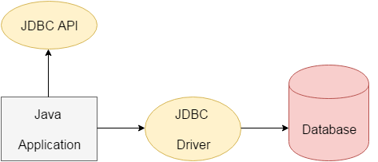
- JDBC API access tabular data stored in any relational database. - JDBC API helps to save, update, delete and fetch data from the database. - Open Database Connectivity (ODBC) provided by Microsoft.

Slide 42
The java.sql package contains classes and interfaces for JDBC API. List of popular interfaces of JDBC API are given below: Driver interface Connection interface Statement interface PreparedStatement interface CallableStatement interface ResultSet interface ResultSetMetaData interface DatabaseMetaData interface RowSet interface A list of popular classes of JDBC API are given below: DriverManager class Blob class Clob class Types class

Slide 43
Why Should We Use JDBC - Before JDBC, ODBC API was the database API to connect and execute the query with the database. - ODBC API uses ODBC driver which is written in C language (i.e. platform dependent and unsecured). That is why Java has defined its own API (JDBC API) that uses JDBC drivers (written in Java language). - JDBC API to handle database using Java program and can perform the following activities: Connect to the database Execute queries and update statements to the database Retrieve the result received from the database.

